Slide 1
Module 2: AWS Shared Responsibility and Intro to IAM
Champlain SYS-360
Slides excerpted from AWS Academy Foundations Course - Module 4
Notes:
Welcome to Module 4: AWS Cloud Security.
Security is the highest priority at Amazon Web Services (AWS). AWS delivers a scalable cloud computing environment that is designed for high availability and dependability, while providing the tools that enable you to run a wide range of applications. Helping to protect the confidentiality, integrity, and availability of your systems and data is critical to AWS, and so is maintaining customer trust and confidence. This module provides an introduction to the AWS approach to security, which includes both the controls in the AWS environment and some of the AWS products and features customers can use to meet their security objectives.

Slide 2
Section 1: AWS shared responsibility model
Notes:
Introducing Section 1: AWS shared responsibility model.

Slide 3
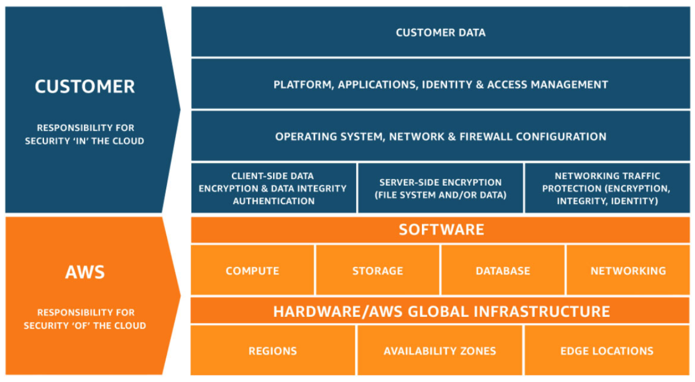
AWS shared responsibility model
Notes:
Security and compliance are a shared responsibility between AWS and the customer. This shared responsibility model is designed to help relieve the customer’s operational burden. At the same time, to provide the flexibility and customer control that enables the deployment of customer solutions on AWS, the customer remains responsible for some aspects of the overall security. The differentiation of who is responsible for what is commonly referred to as security “of” the cloud versus security “in” the cloud.
AWS operates, manages, and controls the components from the software virtualization layer down to the physical security of the facilities where AWS services operate. AWS is responsible for protecting the infrastructure that runs all the services that are offered in the AWS Cloud. This infrastructure is composed of the hardware, software, networking, and facilities that run the AWS Cloud services.
The customer is responsible for the encryption of data at rest and data in transit. The customer should also ensure that the network is configured for security and that security credentials and logins are managed safely. Additionally, the customer is responsible for the configuration of security groups and the configuration of the operating system that run on compute instances that they launch (including updates and security patches).

Slide 4








AWS responsibility: Security of the cloud
AWS responsibilities:
Physical security of data centers
Controlled, need-based access
Hardware and software infrastructure
Storage decommissioning, host operating system (OS) access logging, and auditing
Network infrastructure
Intrusion detection
Virtualization infrastructure
Instance isolation
AWS services
Compute
Storage
Database
Networking
AWS Global Infrastructure
Regions
Availability Zones
Edge locations
Notes:
AWS is responsible for security of the cloud. But what does that mean?
Under the AWS shared responsibility model, AWS operates, manages, and controls the components from the bare metal host operating system and hypervisor virtualization layer down to the physical security of the facilities where the services operate. It means that AWS is responsible for protecting the global infrastructure that runs all the services that are offered in the AWS Cloud. The global infrastructure includes AWS Regions, Availability Zones, and edge locations.
AWS is responsible for the physical infrastructure that hosts your resources, including:
Physical security of data centers with controlled, need-based access; located in nondescript facilities, with 24/7 security guards; two-factor authentication; access logging and review; video surveillance; and disk degaussing and destruction.
Hardware infrastructure, such as servers, storage devices, and other appliances that AWS relies on.
Software infrastructure, which hosts operating systems, service applications, and virtualization software.
Network infrastructure, such as routers, switches, load balancers, firewalls, and cabling. AWS also continuously monitors the network at external boundaries, secures access points, and provides redundant infrastructure with intrusion detection.
Protecting this infrastructure is the top priority for AWS. While you cannot visit AWS data centers or offices to see this protection firsthand, Amazon provides several reports from third-party auditors who have verified our compliance with a variety of computer security standards and regulations.

Slide 5
Customer responsibility: Security in the cloud
Customer responsibilities:
Amazon Elastic Compute Cloud (Amazon EC2) instance operating system
Including patching, maintenance
Applications
Passwords, role-based access, etc.
Security group configuration
OS or host-based firewalls
Including intrusion detection or prevention systems
Network configurations
Account management
Login and permission settings for each user
Customer data
Applications, IAM
Operating system, network, and firewall configuration
Client-side data
encryption and data integrity authentication
Server-side encryption
(file system or data)
Network traffic protection
(encryption, integrity, identity)
Customer-configurable
Notes:
While the cloud infrastructure is secured and maintained by AWS, customers are responsible for security of everything they put in the cloud.
The customer is responsible for what is implemented by using AWS services and for the applications that are connected to AWS. The security steps that you must take depend on the services that you use and the complexity of your system.
Customer responsibilities include selecting and securing any instance operating systems, securing the applications that are launched on AWS resources, security group configurations, firewall configurations, network configurations, and secure account management.
When customers use AWS services, they maintain complete control over their content. Customers are responsible for managing critical content security requirements, including:
What content they choose to store on AWS
Which AWS services are used with the content
In what country that content is stored
The format and structure of that content and whether it is masked, anonymized, or encrypted
Who has access to that content and how those access rights are granted, managed, and revoked
Customers retain control of what security they choose to implement to protect their own data, environment, applications, IAM configurations, and operating systems.

Slide 6






Service characteristics and security responsibility (1 of 2)
Example services managed by the customer
Infrastructure as a service (IaaS)
Customer has more flexibility over configuring networking and storage settings
Customer is responsible for managing more aspects of the security
Customer configures the access controls
Platform as a service (PaaS)
Customer does not need to manage the underlying infrastructure
AWS handles the operating system, database patching, firewall configuration, and disaster recovery
Customer can focus on managing code or data
Amazon EC2
Amazon Elastic Block Store (Amazon EBS)
Amazon Virtual Private Cloud (Amazon VPC)
Example services managed by AWS
AWS Lambda
Amazon Relational Database Service (Amazon RDS)
AWS Elastic Beanstalk
Notes:
Infrastructure as a service (IaaS) refers to services that provide basic building blocks for cloud IT, typically including access to configure networking, computers (virtual or on dedicated hardware), and data storage space. Cloud services that can be characterized as IaaS provide the customer with the highest level of flexibility and management control over IT resources. IaaS services are most similar to existing on-premises computing resources that many IT departments are familiar with today.
AWS services—such as Amazon EC2—can be categorized as IaaS and thus require the customer to perform all necessary security configuration and management tasks. Customers who deploy EC2 instances are responsible for managing the guest operating system (including updates and security patches), any application software that is installed on the instances, and the configuration of the security groups that were provided by AWS.
Platform as a service (PaaS) refers to services that remove the need for the customer to manage the underlying infrastructure (hardware, operating systems, etc.). PaaS services enable the customer to focus entirely on deploying and managing applications. Customers don’t need to worry about resource procurement, capacity planning, software maintenance, or patching.
AWS services such as AWS Lambda and Amazon RDS can be categorized as PaaS because AWS operates the infrastructure layer, the operating system, and platforms. Customers only need to access the endpoints to store and retrieve data. With PaaS services, customers are responsible for managing their data, classifying their assets, and applying the appropriate permissions. However, these service act more like managed services, with AWS handling a larger portion of the security requirements. For these services, AWS handles basic security tasks—such as operating system and database patching, firewall configuration, and disaster recovery.

Slide 7



Service characteristics and security responsibility (2 of 2)
SaaS examples
Software as a service (SaaS)
Software is centrally hosted
Licensed on a subscription model or pay-as-you-go basis.
Services are typically accessed via web browser, mobile app, or application programming interface (API)
Customers do not need to manage the infrastructure that supports the service
AWS Trusted
Advisor
AWS Shield
Amazon Chime
Notes:
Software as a service (SaaS) refers to services that provide centrally hosted software that is typically accessible via a web browser, mobile app, or application programming interface (API). The licensing model for SaaS offerings is typically subscription or pay as you go. With SaaS offerings, customers do not need to manage the infrastructure that supports the service. Some AWS services—such as AWS Trusted Advisor, AWS Shield, and Amazon Chime—could be categorized as SaaS offerings, given their characteristics.
AWS Trusted Advisor is an online tool that analyzes your AWS environment and provides real-time guidance and recommendations to help you provision your resources by following AWS best practices. The Trusted Advisor service is offered as part of your AWS Support plan. Some of the Trusted Advisor features are free to all accounts, but Business Support and Enterprise Support customers have access to the full set of Trusted Advisor checks and recommendations.
AWS Shield is a managed distributed denial of service (DDoS) protection service that safeguards applications running on AWS. It provides always-on detection and automatic inline mitigations that minimize application downtime and latency, so there is no need to engage AWS Support to benefit from DDoS protection. AWS Shield Advanced is available to all customers. However, to contact the DDoS Response Team, customers must have either Enterprise Support or Business Support from AWS Support.
Amazon Chime is a communications service that enables you to meet, chat, and place business calls inside and outside your organization, all using a single application. It is a pay-as-you-go communications service with no upfront fees, commitments, or long-term contracts.

Slide 8

Activity: AWS shared responsibility model
Photo by Pixabay from Pexels.
Notes:
In this educator-led activity, you will be presented with two scenarios. For each scenario, you will be asked several questions about whose responsibility it is (AWS or the customer) to ensure security of the item in question. The educator will lead the class in a discussion of each question and reveal the correct answers one at a time.

Slide 9




Activity: Scenario 1 of 2
Consider this deployment. Who is responsible – AWS or the customer?
AWS Cloud
Upgrades and patches to the operating system on the EC2 instance?
Physical security of the data center?
Virtualization infrastructure?
EC2 security group settings?
Configuration of applications that run on the EC2 instance?
Oracle upgrades or patches If the Oracle instance runs as an Amazon RDS instance?
Oracle upgrades or patches If Oracle runs on an EC2 instance?
S3 bucket access configuration?
Virtual Private Cloud (VPC)
Amazon Simple Storage Service (Amazon S3)
Amazon EC2
Oracle instance
AWS Global Infrastructure
Notes:
Consider the case where a customer uses the AWS services and resources that are shown here. Who is responsible for maintaining security? AWS or the customer?

Slide 10
Activity: Scenario 1 of 2 Answers
Consider this deployment. Who is responsible – AWS or the customer?
AWS Cloud
Upgrades and patches to the operating system on the EC2 instance?
ANSWER: The customer
Physical security of the data center?
ANSWER: AWS
Virtualization infrastructure?
ANSWER: AWS
EC2 security group settings?
ANSWER: The customer
Configuration of applications that run on the EC2 instance?
ANSWER: The customer
Oracle upgrades or patches If the Oracle instance runs as an Amazon RDS instance?
ANSWER: AWS
Oracle upgrades or patches If Oracle runs on an EC2 instance?
ANSWER: The customer
S3 bucket access configuration?
ANSWER: The customer
Virtual Private Cloud (VPC)
Amazon Simple Storage Service (Amazon S3)
Amazon EC2
Oracle instance
AWS Global Infrastructure
Notes:
The customer uses Amazon Simple Storage Service (Amazon S3) to store data. The customer configured a virtual private cloud (VPC) with Amazon Virtual Private Cloud (Amazon VPC). The EC2 instance and the Oracle database instance that they created both run in the VPC.
In this example, the customer must manage the guest operating system (OS) that runs on the EC2 instance. Over time, the guest OS will need to be upgraded and have security patches applied. Additionally, any application software or utilities that the customer installed on the Amazon EC2 instance must also be maintained. The customer is responsible for configuring the AWS firewall (or security group) that is applied to the Amazon EC2 instance. The customer is also responsible for the VPC configurations that specify the network conditions in which the Amazon EC2 instance runs. These tasks are the same security tasks that IT staff would perform, no matter where their servers are located.
The Oracle instance in this example provides an interesting case study in terms of AWS or customer responsibility. If the database runs on an EC2 instance, then it is the customer's responsibility to apply Oracle software upgrades and patches. However, if the database runs as an Amazon RDS instance, then it is the responsibility of AWS to apply Oracle software upgrades and patches. Because Amazon RDS is a managed database offering, time-consuming database administration tasks—which include provisioning, backups, software patching, monitoring, and hardware scaling—are handled by AWS. To learn more, see Best Practices for Running Oracle Database on AWS at https://docs.aws.amazon.com/whitepapers/latest/oracle-database-aws-best-practices/oracle-database-aws-best-practices.html for details.

Slide 11







Activity: Scenario 2 of 2
Consider this deployment. Who is responsible – AWS or the customer?
Secure Shell (SSH) keys
Ensuring that the AWS Management Console is not hacked?
Configuring the subnet?
Configuring the VPC?
Protecting against network outages in AWS Regions?
Securing the SSH keys
Ensuring network isolation between AWS customers' data?
Ensuring low-latency network connection between the web server and the S3 bucket?
Enforcing multi-factor authentication for all user logins?
AWS Command Line Interface (AWS CLI)
AWS Management Console
Internet gateway
VPC
Subnet
Web server on Amazon EC2
S3 bucket with objects
Notes:
Now, consider this additional case where a customer uses the AWS services and resources that are shown here. Who is responsible for maintaining security? AWS or the customer?

Slide 12
Activity: Scenario 2 of 2 Answers
Consider this deployment. Who is responsible – AWS or the customer?
Secure Shell (SSH) keys
Ensuring that the AWS Management Console is not hacked?
ANSWER: AWS
Configuring the subnet?
ANSWER: The customer
Configuring the VPC?
ANSWER: The customer
Protecting against network outages in AWS Regions?
ANSWER: AWS
Securing the SSH keys
ANSWER: The customer
Ensuring network isolation between AWS customers' data?
ANSWER: AWS
Ensuring low-latency network connection between the web server and the S3 bucket?
ANSWER: AWS
Enforcing multi-factor authentication for all user logins?
ANSWER: The customer
AWS Command Line Interface (AWS CLI)
AWS Management Console
Internet gateway
VPC
Subnet
Web server on Amazon EC2
S3 bucket with objects
Notes:
A customer uses Amazon S3 to store data. The customer configured a virtual private cloud (VPC) with Amazon VPC, and is running a web server on an EC2 instance in the VPC. The customer configured an internet gateway as part of the VPC so that the web server can be reached by using the AWS Management Console or the AWS Command Line Interface (AWS CLI). When the customer uses the AWS CLI, the connection requires the use of Secure Shell (SSH) keys.

Slide 13

Section 1 key takeaways
AWS and the customer share security responsibilities:
AWS is responsible for security of the cloud
Customer is responsible for security in the cloud
AWS is responsible for protecting the infrastructure—including hardware, software, networking, and facilities—that run AWS Cloud services
For services that are categorized as infrastructure as a service (IaaS), the customer is responsible for performing necessary security configuration and management tasks
For example, guest OS updates and security patches, firewall, security group configurations
Notes:
Some key takeaways from this section of the module include:
AWS and the customer share security responsibilities –
AWS is responsible for security of the cloud
Customer is responsible for security in the cloud
AWS is responsible for protecting the infrastructure—including hardware, software, networking, and facilities—that run AWS Cloud services
For services that are categorized as infrastructure as a service (IaaS), the customer is responsible for performing necessary security configuration and management tasks
For example, guest OS updates and security patches, firewall, security group configurations

Slide 14
Section 2: AWS Identity and Access Management (IAM)
Module 4: AWS Cloud Security
Notes:
Introducing Section 2: AWS Identity and Access Management (or IAM).

Slide 15

AWS Identity and Access Management (IAM)
Use IAM to manage access to AWS resources –
A resource is an entity in an AWS account that you can work with
Example resources; An Amazon EC2 instance or an Amazon S3 bucket
Example – Control who can terminate Amazon EC2 instances
Define fine-grained access rights –
Who can access the resource
Which resources can be accessed and what can the user do to the resource
How resources can be accessed
IAM is a no-cost AWS account feature
AWS Identity and Access Management
(IAM)
Notes:
AWS Identity and Access Management (IAM) allows you to control access to compute, storage, database, and application services in the AWS Cloud. IAM can be used to handle authentication, and to specify and enforce authorization policies so that you can specify which users can access which services.
IAM is a tool that centrally manages access to launching, configuring, managing, and terminating resources in your AWS account. It provides granular control over access to resources, including the ability to specify exactly which API calls the user is authorized to make to each service. Whether you use the AWS Management Console, the AWS CLI, or the AWS software development kits (SDKs), every call to an AWS service is an API call.
With IAM, you can manage which resources can be accessed by who, and how these resources can be accessed. You can grant different permissions to different people for different resources. For example, you might allow some users full access to Amazon EC2, Amazon S3, Amazon DynamoDB, Amazon Redshift, and other AWS services. However, for other users, you might allow read-only access to only a few S3 buckets. Similarly, you might grant permission to other users to administer only specific EC2 instances. You could also allow a few users to access only the account billing information, but nothing else.
IAM is a feature of your AWS account, and it is offered at no additional charge.

Slide 16




IAM: Essential components
A person or application that can authenticate with an AWS account.
IAM user
A collection of IAM users that are granted identical authorization.
IAM group
The document that defines which resources can be accessed and the level of access to each resource.
IAM policy
Useful mechanism to grant a set of permissions for making AWS service requests.
IAM role
Notes:
To understand how to use IAM to secure your AWS account, it is important to understand the role and function of each of the four IAM components.
An IAM user is a person or application that is defined in an AWS account, and that must make API calls to AWS products. Each user must have a unique name (with no spaces in the name) within the AWS account, and a set of security credentials that is not shared with other users. These credentials are different from the AWS account root user security credentials. Each user is defined in one and only one AWS account.
An IAM group is a collection of IAM users. You can use IAM groups to simplify specifying and managing permissions for multiple users.
An IAM policy is a document that defines permissions to determine what users can do in the AWS account. A policy typically grants access to specific resources and specifies what the user can do with those resources. Policies can also explicitly deny access.
An IAM role is a tool for granting temporary access to specific AWS resources in an AWS account.

Slide 17

Authenticate as an IAM user to gain access
When you define an IAM user, you select what types of access the user is permitted to use.
Programmatic access
Authenticate using:
Access key ID
Secret access key
Provides AWS CLI and AWS SDK access
AWS Management Console access
Authenticate using:
12-digit Account ID or alias
IAM user name
IAM password
If enabled, multi-factor authentication (MFA) prompts for an authentication code.
AWS CLI
AWS Tools and SDKs
AWS Management Console
Notes:
Authentication is a basic computer security concept: a user or system must first prove their identity. Consider how you authenticate yourself when you go to the airport and you want to get through airport security so that you can catch your flight. In this situation, you must present some form of identification to the security official to prove who you are before you can enter a restricted area. A similar concept applies for gaining access to AWS resources in the cloud.
When you define an IAM user, you select what type of access the user is permitted to use to access AWS resources. You can assign two different types of access to users: programmatic access and AWS Management Console access. You can assign programmatic access only, console access only, or you can assign both types of access.
If you grant programmatic access, the IAM user will be required to present an access key ID and a secret access key when they make an AWS API call by using the AWS CLI, the AWS SDK, or some other development tool.
If you grant AWS Management Console access, the IAM user will be required to fill in the fields that appear in the browser login window. The user is prompted to provide either the 12-digit account ID or the corresponding account alias. The user must also enter their IAM user name and password. If multi-factor authentication (MFA) is enabled for the user, they will also be prompted for an authentication code.

Slide 18
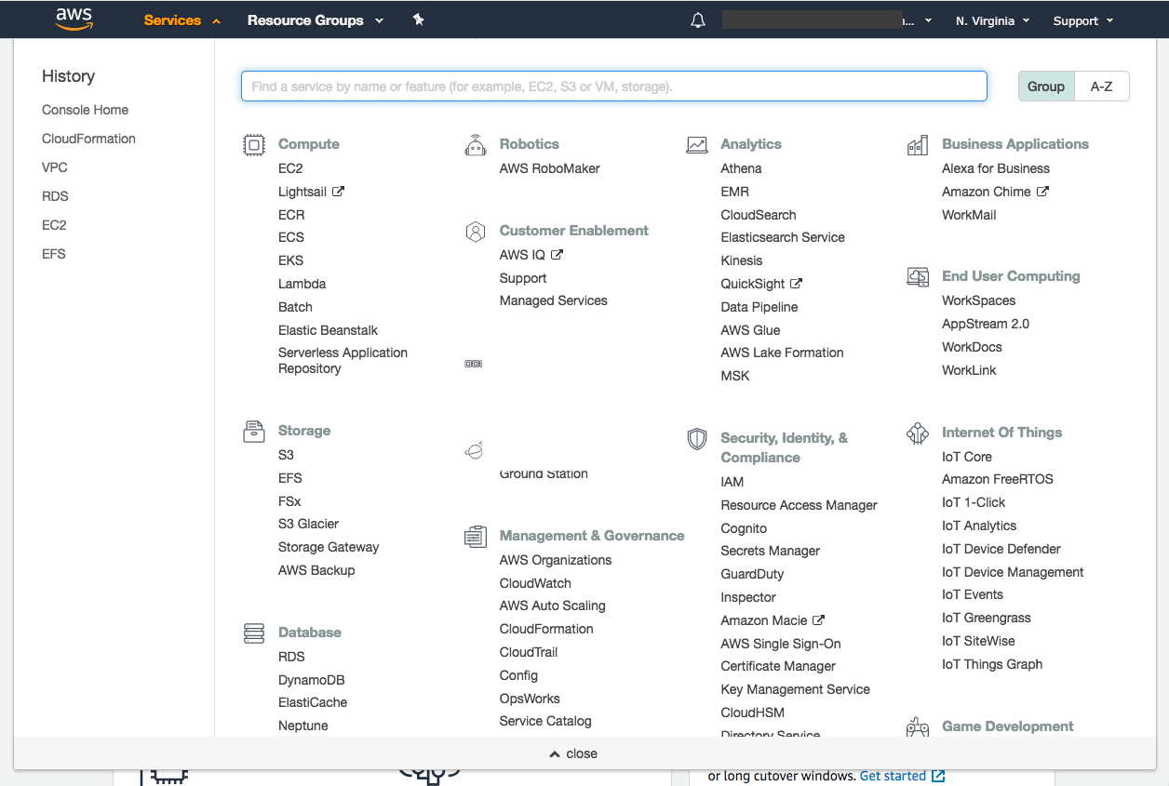

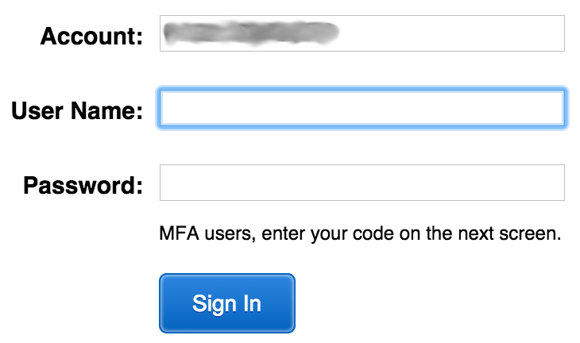

IAM MFA
MFA provides increased security.
In addition to username and password, MFA requires a unique authentication code to access AWS services.
Username and password
MFA token
AWS Management Console
Notes:
AWS services and resources can be accessed by using the AWS Management Console, the AWS CLI, or through SDKs and APIs. For increased security, we recommend enabling MFA.
With MFA, users and systems must provide an MFA token—in addition to the regular sign-in credentials—before they can access AWS services and resources.
Options for generating the MFA authentication token include virtual MFA-compliant applications (such as Google Authenticator or Authy 2-Factor Authentication), U2F security key devices, and hardware MFA devices.

Slide 19



Authorization: What actions are permitted
After the user or application is connected to the AWS account, what are they allowed to do?
EC2 instances
Full access
Read-only
IAM user, IAM group, or IAM role
S3 bucket
IAM policies
Notes:
Authorization is the process of determining what permissions a user, service or application should be granted. After a user has been authenticated, they must be authorized to access AWS services.
By default, IAM users do not have permissions to access any resources or data in an AWS account. Instead, you must explicitly grant permissions to a user, group, or role by creating a policy, which is a document in JavaScript Object Notation (JSON) format. A policy lists permissions that allow or deny access to resources in the AWS account.

Slide 20
IAM: Authorization
Assign permissions by creating an IAM policy.
Permissions determine which resources and operations are allowed:
All permissions are implicitly denied by default.
If something is explicitly denied, it is never allowed.
Best practice: Follow the principle of least privilege.
Note: The scope of IAM service configurations is global. Settings apply across all AWS Regions.
IAM permissions
Notes:
To assign permission to a user, group or role, you must create an IAM policy (or find an existing policy in the account). There are no default permissions. All actions in the account are denied to the user by default (implicit deny) unless those actions are explicitly allowed. Any actions that you do not explicitly allow are denied. Any actions that you explicitly deny are always denied.
The principle of least privilege is an important concept in computer security. It promotes that you grant only the minimal user privileges needed to the user, based on the needs of your users. When you create IAM policies, it is a best practice to follow this security advice of granting least privilege. Determine what users need to be able to do and then craft policies for them that let the users perform only those tasks. Start with a minimum set of permissions and grant additional permissions as necessary. Doing so is more secure than starting with permissions that are too broad and then later trying to lock down the permissions granted.
Note that the scope of the IAM service configurations is global. The settings are not defined at an AWS Region level. IAM settings apply across all AWS Regions.

Slide 21

IAM policies
An IAM policy is a document that defines permissions
Enables fine-grained access control
Two types of policies – identity-based and resource-based
Identity-based policies –
Attach a policy to any IAM entity
An IAM user, an IAM group, or an IAM role
Policies specify:
Actions that may be performed by the entity
Actions that may not be performed by the entity
A single policy can be attached to multiple entities
A single entity can have multiple policies attached to it
Resource-based policies
Attached to a resource (such as an S3 bucket)
IAM entities
Attach to one of
IAM user
IAM policy
IAM group
IAM role
Notes:
An IAM policy is a formal statement of permissions that will be granted to an entity. Policies can be attached to any IAM entity. Entities include users, groups, roles, or resources. For example, you can attach a policy to AWS resources that will block all requests that do not come from an approved Internet Protocol (IP) address range. Policies specify what actions are allowed, which resources to allow the actions on, and what the effect will be when the user requests access to the resources.
The order in which the policies are evaluated has no effect on the outcome of the evaluation. All policies are evaluated, and the result is always that the request is either allowed or denied. When there is a conflict, the most restrictive policy applies.
There are two types of IAM policies. Identity-based policies are permissions policies that you can attach to a principal (or identity) such as an IAM user, role, or group. These policies control what actions that identity can perform, on which resources, and under what conditions. Identity-based policies can be further categorized as:
Managed policies – Standalone identity-based policies that you can attach to multiple users, groups, and roles in your AWS account
Inline policies – Policies that you create and manage, and that are embedded directly into a single user group or role.
Resource-based policies are JSON policy documents that you attach to a resource, such as an S3 bucket. These policies control what actions a specified principal can perform on that resource, and under what conditions.

Slide 22
IAM policy example
{
"Version": "2012-10-17",
"Statement":[{
"Effect":"Allow",
"Action":["DynamoDB:*","s3:*"],
"Resource":[ "arn:aws:dynamodb:region:account-number-without-hyphens:table/table-name",
"arn:aws:s3:::bucket-name",
"arn:aws:s3:::bucket-name/*"]
},
{
"Effect":"Deny",
"Action":["dynamodb:*","s3:*"],
"NotResource":["arn:aws:dynamodb:region:account-number-without-hyphens:table/table-name”,
"arn:aws:s3:::bucket-name",
"arn:aws:s3:::bucket-name/*"]
}
]
}
Explicit allow gives users access to a specific DynamoDB table and…
…Amazon S3 buckets.
Explicit deny ensures that the users cannot use any other AWS actions or resources other than that table and those buckets.
An explicit deny statement takes precedence over an allow statement.
Notes:
As mentioned previously, IAM policy documents are written in JSON.
The example IAM policy grants users access only to the following resources:
The DynamoDB table whose name is represented by table-name.
The AWS account's S3 bucket, whose name is represented by bucket-name and all the objects that it contains.
The IAM policy also includes an explicit deny ("Effect":"Deny") element. The NotResource element helps to ensure that users cannot use any other DynamoDB or S3 actions or resources except the actions and resources that are specified in the policy—even if permissions have been granted in another policy. An explicit deny statement takes precedence over an allow statement.

Slide 23


Resource-based policies
Identity-based policies are attached to a user, group, or role
Resource-based policies are attached to a resource (not to a user, group or role)
Characteristics of resource-based policies –
Specifies who has access to the resource and what actions they can perform on it
The policies are inline only, not managed
Resource-based policies are supported only by some AWS services
AWS Account
IAM user MaryMajor
S3 bucket photos
attached
Defined inline
on the bucket
Identity-based policy
Resource-based policy
Policy grants list, read objects to the photos bucket
Policy grants user MaryMajor list, read objects
Notes:
While identity-based policies are attached to a user, group, or role, resource-based policies are attached to a resource, such as an S3 bucket. These policies specify who can access the resource and what actions they can perform on it.
Resource-based policies are defined inline only, which means that you define the policy on the resource itself, instead of creating a separate IAM policy document that you attach. For example, to create an S3 bucket policy (a type of resource-based policy) on an S3 bucket, navigate to the bucket, click the Permissions tab, click the Bucket Policy button, and define the JSON-formatted policy document there. An Amazon S3 access control list (ACL) is another example of a resource-based policy.
The diagram shows two different ways that the user MaryMajor could be granted access to objects in the S3 bucket that is named photos. On the left, you see an example of an identity-based policy. An IAM policy that grants access to the S3 bucket is attached to the MaryMajor user. On the right, you see an example of a resource-based policy. The S3 bucket policy for the photos bucket specifies that the user MaryMajor is allowed to list and read the objects in the bucket.
Note that you could define a deny statement in a bucket policy to restrict access to specific IAM users, even if the users are granted access in a separate identity-based policy. An explicit deny statement will always take precedence over any allow statement.

Slide 24
IAM permissions
How IAM determines permissions:
Is the permission explicitly denied ?
Is the permission explicitly allowed ?
No
No
Deny
Implicit deny
Yes
Yes
Deny
Allow
Notes:
IAM policies enable you to fine-tune privileges that are granted to IAM users, groups, and roles.
When IAM determines whether a permission is allowed, IAM first checks for the existence of any applicable explicit denial policy. If no explicit denial exists, it then checks for any applicable explicit allow policy. If neither an explicit deny nor an explicit allow policy exists, IAM reverts to the default, which is to deny access. This process is referred to as an implicit deny. The user will be permitted to take the action only if the requested action is not explicitly denied and is explicitly allowed.
It can be difficult to figure out whether access to a resource will be granted to an IAM entity when you develop IAM policies. The IAM Policy Simulator at https://docs.aws.amazon.com/IAM/latest/UserGuide/access_policies_testing-policies.html is a useful tool for testing and troubleshooting IAM policies.

Slide 25
IAM groups
An IAM group is a collection of IAM users
A group is used to grant the same permissions to multiple users
Permissions granted by attaching IAM policy or policies to the group
A user can belong to multiple groups
There is no default group
Groups cannot be nested
AWS account
IAM group:
Admins
IAM group:
Developers
IAM group:
Testers
Carlos Salazar
Li Juan
Zhang Wei
Márcia Oliveira
Mary Major
John Stiles
Richard Roe
Li Juan
Notes:
An IAM group is a collection of IAM users. IAM groups offer a convenient way to specify permissions for a collection of users, which can make it easier to manage the permissions for those users.
For example, you could create an IAM group that is called Developers and attach an IAM policy or multiple IAM policies to the Developers group that grant the AWS resource access permissions that developers typically need. Any user that you then add to the Developer group will automatically have the permissions that are assigned to the group. In such a case, you do not need to attach the IAM policy or IAM policies directly to the user. If a new user joins your organization and should be granted developer privileges, you can simply add that user to the Developers group. Similarly, if a person changes jobs in your organization, instead of editing that user's permissions, simply remove the user from the group.
Important characteristics of IAM groups:
A group can contain many users, and a user can belong to multiple groups.
Groups cannot be nested. A group can contain only users, and a group cannot contain other groups.
There is no default group that automatically includes all users in the AWS account. If you want to have a group with all account users in it, you need to create the group and add each new user to it.

Slide 26
IAM roles
An IAM role is an IAM identity with specific permissions
Similar to an IAM user
Attach permissions policies to it
Different from an IAM user
Not uniquely associated with one person
Intended to be assumable by a person, application, or service
Role provides temporary security credentials
Examples of how IAM roles are used to delegate access –
Used by an IAM user in the same AWS account as the role
Used by an AWS service—such as Amazon EC2—in the same account as the role
Used by an IAM user in a different AWS account than the role
IAM role
Notes:
An IAM role is an IAM identity you can create in your account that has specific permissions. An IAM role is similar to an IAM user because it is also an AWS identity that you can attach permissions policies to, and those permissions determine what the identity can and cannot do in AWS. However, instead of being uniquely associated with one person, a role is intended to be assumable by anyone who needs it. Also, a role does not have standard long-term credentials such as a password or access keys associated with it. Instead, when you assume a role, the role provides you with temporary security credentials for your role session.
You can use roles to delegate access to users, applications, or services that do not normally have access to your AWS resources. For example, you might want to grant users in your AWS account access to resources they don't usually have, or grant users in one AWS account access to resources in another account. Or you might want to allow a mobile app to use AWS resources, but you do not want to embed AWS keys within the app (where the keys can be difficult to rotate and where users can potentially extract them and misuse them). Also, sometimes you may want to grant AWS access to users who already have identities that are defined outside of AWS, such as in your corporate directory. Or, you might want to grant access to your account to third parties so that they can perform an audit on your resources.
For all of these example use cases, IAM roles are an essential component to implementing the cloud deployment.

Slide 27


Example use of an IAM role
Scenario:
An application that runs on an EC2 instance needs access to an S3 bucket
Solution:
Define an IAM policy that grants access to the S3 bucket.
Attach the policy to a role
Allow the EC2 instance to assume the role
AWS Cloud
Application has permissions to access the S3 bucket
Amazon EC2 instance
Application
3
Amazon S3 bucket photos
Role assumed by the EC2 instance
2
attached
IAM role
1
IAM policy grants access to photos bucket
Notes:
In the diagram, a developer runs an application on an EC2 instance that requires access to the S3 bucket that is named photos. An administrator creates the IAM role and attaches the role to the EC2 instance. The role includes a permissions policy that grants read-only access to the specified S3 bucket. It also includes a trust policy that allows the EC2 instance to assume the role and retrieve the temporary credentials. When the application runs on the instance, it can use the role's temporary credentials to access the photos bucket. The administrator does not need to grant the application developer permission to access the photos bucket, and the developer never needs to share or manage credentials.
To learn more details about this example, see Using an IAM Role to Grant Permissions to Applications Running on Amazon EC2 Instances at https://docs.aws.amazon.com/IAM/latest/UserGuide/id_roles_use_switch-role-ec2.html.

Slide 28
Section 2 key takeaways
IAM policies are constructed with JavaScript Object Notation (JSON) and define permissions.
IAM policies can be attached to any IAM entity.
Entities are IAM users, IAM groups, and IAM roles.
An IAM user provides a way for a person, application, or service to authenticate to AWS.
An IAM group is a simple way to attach the same policies to multiple users.
An IAM role can have permissions policies attached to it and can be used to delegate temporary access to users or applications.
Notes:
Some key takeaways from this section of the module include:
IAM policies are constructed with JavaScript Object Notation (JSON) and define permissions.
IAM policies can be attached to any IAM entity.
Entities are IAM users, IAM groups, and IAM roles.
An IAM user provides a way for a person, application, or service to authenticate to AWS.
An IAM group is a simple way to attach the same policies to multiple users.
An IAM role can have permissions policies attached to it, and can be used to delegate temporary access to users or applications.

